Slide 1
MACHINE LEARNING
K-MEANS CLUSTERING

Slide 2
Very popular unsupervised learning algorithm in data mining
Automatically divides the data into clusters / groupings of similar items + it does this without having been told what the groups should look like ahead of time !!!
Problem: how could a computer possibly know where one group ends and another begins?
Elements inside a cluster should be very similar to each other, but very different from those outside
k-means clustering aims to partition n observations into k clusters in which each observation belongs to the cluster with the nearest mean
Can be done with graph algorithms: construct the minimum spanning tree...and remove the last k edges
An NP-hard problem
Lloyd algorithm is very common nowadays

Slide 3
Lloyd-algorithm
Initialize the centroids at random, these are the centers of a given cluster
Decide for every point in our dataset, what centroid is the nearest to them
Calculate the new means of every distinct clusters // run until convergence !!!

Slide 4
x2
x1

Slide 5
x2
x1

Slide 6
x2
x1

Slide 7
d1
x2
d2
d3
x1

Slide 8
Calculate the min {d1,d2,d3} !!!
d1
x2
d2
d3
x1

Slide 9
Calculate the min {d1,d2,d3} !!!
It is a green point because the nearest centroid the the
green one !!!
d1
x2
d2
d3
x1

Slide 10
Calculate the min {d1,d2,d3} !!!
It is a green point because the nearest centroid the the
green one !!!
d1
WE HAVE TO DO IT TO
EVERY POINTS !!!
x2
d2
d3
x1

Slide 11
x2
x1

Slide 12
x2
x1

Slide 13
x2
x1

Slide 14
x2
x1

Slide 15
Finding k parameter
Sometimes we have some a priori knowledge: we know how many clusters we want to construct
Without any a priori knowledge: k is approximately equal to the square root of n/2
// n is the number of elements in the dataset
Elbow method: we monitor the change of homogeneity within the clusters with different k values
It looks at the percentage of variance explained as a function of the number of clusters: one should choose a number of clusters so that adding another cluster does not give much better modeling of the data
We have to find the „elbow point” at a plot

Slide 16
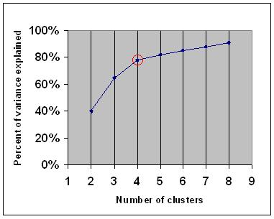

Slide 17
advantages
disadvantages
Relies on simple principles
to identify clusters
Flexible
Efficient
Not so sophisticated
Because it uses an element
of random chance, it is not
guaranteed to find the optimal set
of clusters
k parameter: we have to know in advance
how many clusters we want to find

Slide 18
Clustering is different from classification or numerical predictions
Classification / regression: the result is a model that relates features to an outcome
Clustering: creates new data !!!
Unlabeled examples are given a cluster label and inferred entirely from the relationships within the data

